Slide 1
SDC: Social Dispersed Computing for Decentralized Cyber-Physical Systems
Abhishek Dubey
Assistant Professor
Vanderbilt University
Aron Laszka
Research Assistant Professor
Vanderbilt University

Slide 2
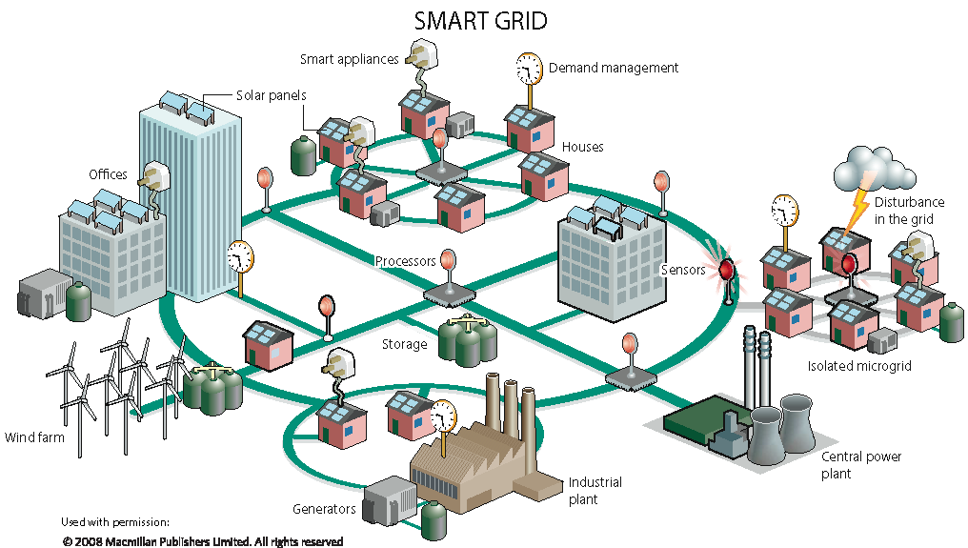
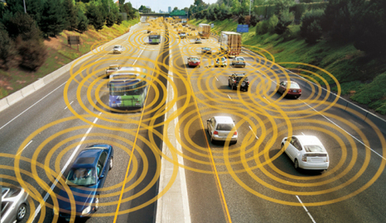

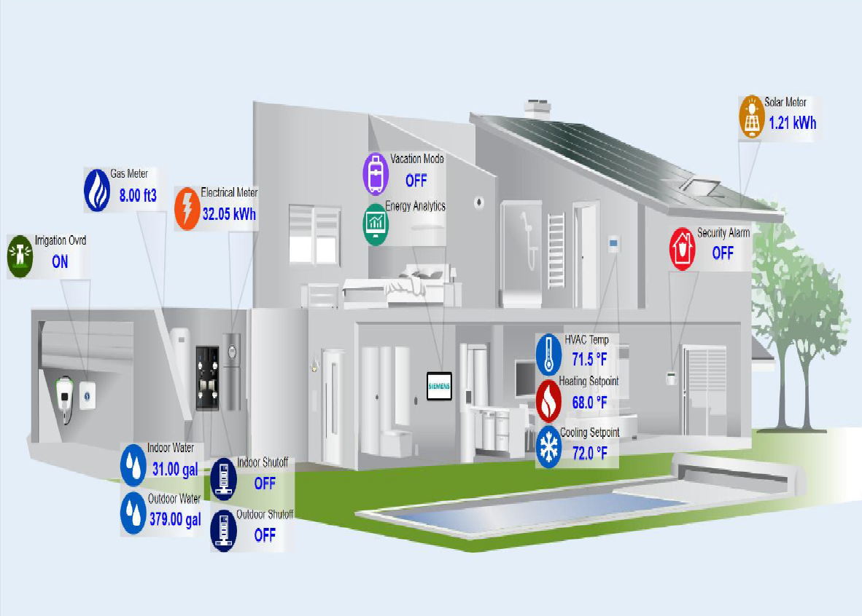
The trend of decentralization in CPS
Microgrids
Transportation
Health Care
Smart Buildings
CPS are a generalization of Internet of Things (IoT)
CPS= Computation Software + Physical system + Networks+ Coordinated + Closed-loop
Notes:
Each provider and each senior living center has their own information – what if people keep the information in their control – can keep control.

Slide 3

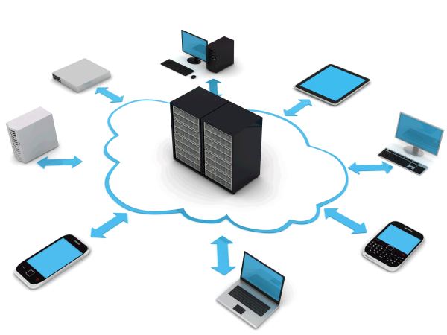
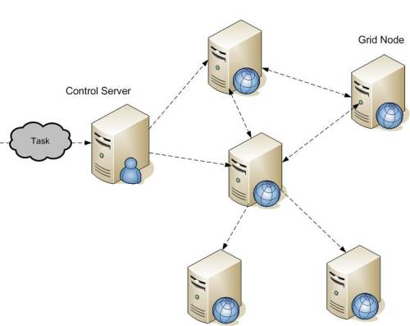
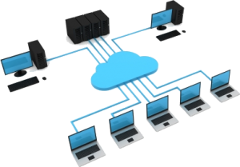
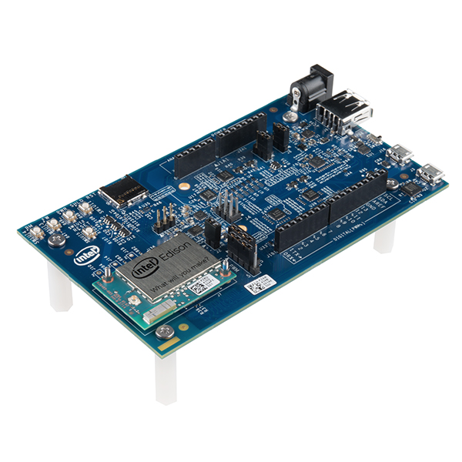
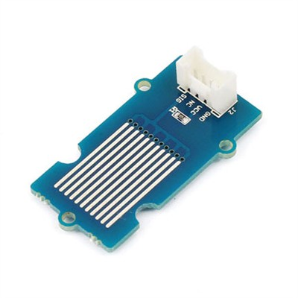
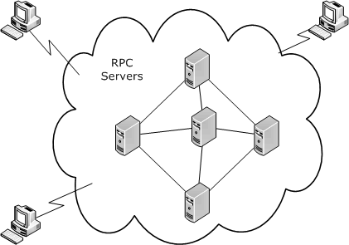
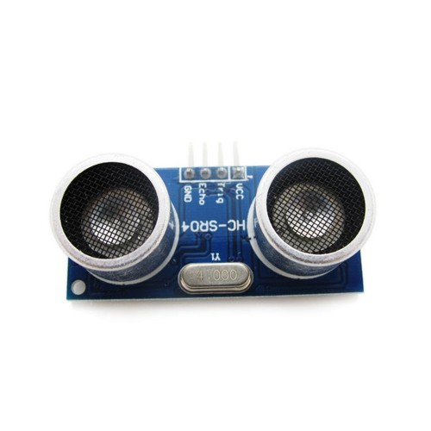
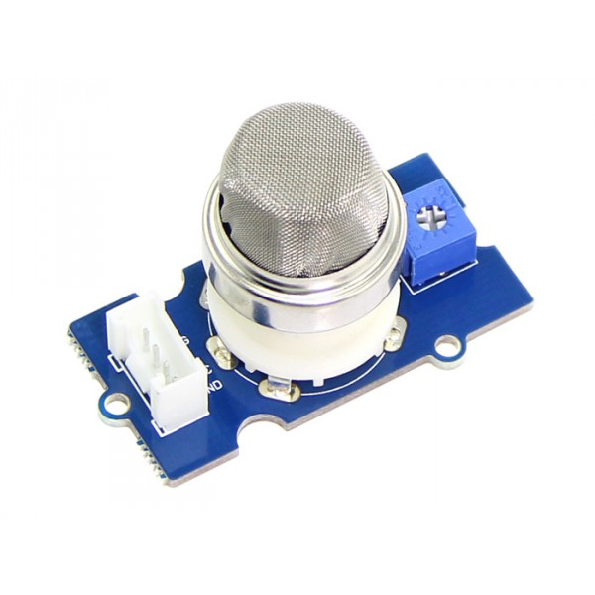
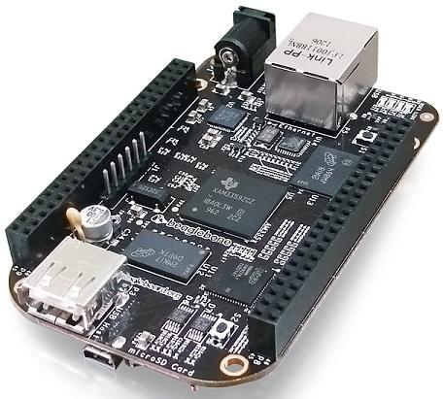
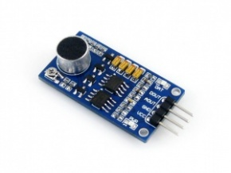
What’s enabling this trend of decentralization?
Ubiquitous Computing (mobile, IoT, IIoT)
Grid Computing
Present
Social Dispersed Computing
Late 2000s
Single board computers
Mid 2000s
Mid 1990s
Cloud Computing
Small Homogeneous Clusters

Slide 4
What is Social Dispersed Computing
Similar to grid computing in concept.
However, massively distributed across heterogeneous devices with varying levels of trust.
Advantage: A resilient and redundant computation surface close to the physical process under control

Slide 5
Example #1: Video Analytics
10X
Servers:
Event recognition
tracking
1Mbps
10X
1Mbps
10Mbps
1Gbps
10x
100Mbps X 10
1Mbps
10X
10Mbps
1Mbps
Notes:
The illustration shows a (naïve) implementation of a wide area security surveillance system based on off-the-shelf webcams, switches, routers, and cloud-based servers. 10 cameras are grouped together, and we have 10 such groups in each neighborhood (i.e. 100 cameras per neighborhood), and we have 10 such neighborhoods in a city (i.e. 1000 cameras in a city). The goal is to perform ‘event’ (i.e. accident, crime, etc.) recognition and tracking on the images. The cameras take an image (~1M bits) every second, then this traffic gets aggregated from 10 cameras and routed through switches (10Mbps output flow) and routers ( 100Mbps output flows) we end up with a 1GBps sustained network flow to the servers that perform event recognition and tracking. It is questionable that this implementation would work.

Slide 6
Example #1: Video Analytics
10X
NCP
0.1Mbps
NCP
Workstations
10X
NCP
0.1Mbps
0.1Mbps
10Mbps
10x
1Mbps X 10
NCP
0.1Mbps
NCP
10X
0.1Mbps
NCP
0.1Mbps
Notes:
An alternative implementation is shown on the figure that relies on NCP-s: the cameras and the first layer of switches are also capable of local processing. The cameras exhibit a much smaller output data rate: assuming 0.1 Mbps (this is likely an overestimate) - as they report only detected events, and the switch NCP-s also perform detection and tracking functions, also generating a much smaller output data rate. The highest rate is at the top router (on the right), for which the worst case rate is 10Mbps – easily within the limits of modern networking and computing hardware. Also, this is likely to be more bursty and less sustained due to the detection and filtering.
This architecture can be realized today with existing hardware and software, but it necessitates significant effort in planning, implementation, installation, and management – mostly manual activities. The proposed framework will automate this process to a large degree and make the engineering, implementation, and operation of such systems feasible with reduced effort and higher reliability.

Slide 7
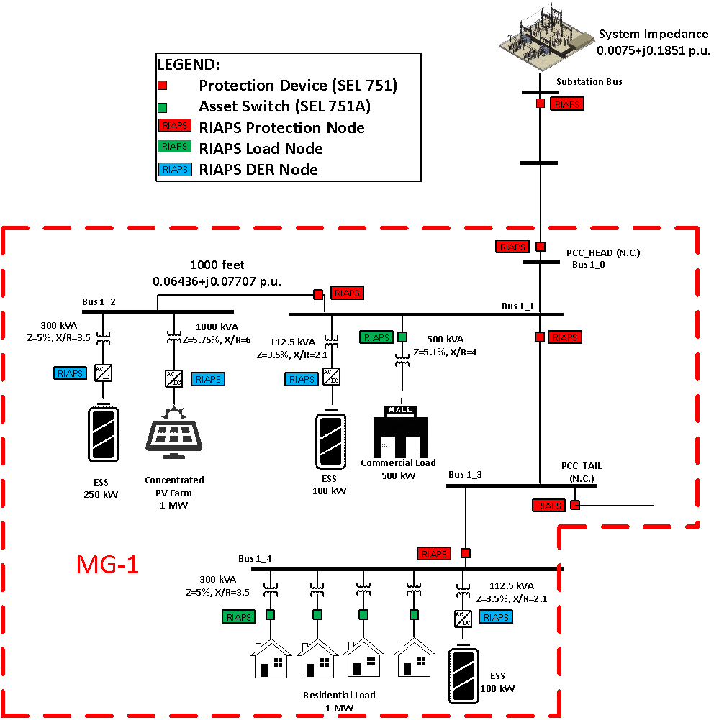
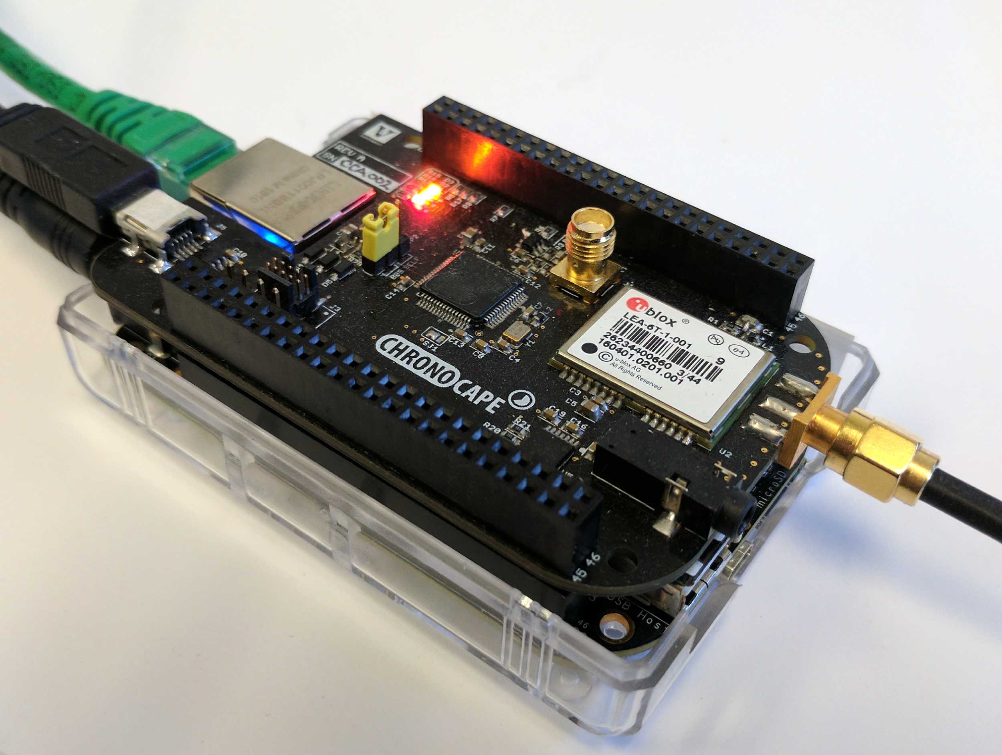
Example #2: Decentralized Transactive Microgrids
Balance voltage and frequency within the microgrid
Support islanding operations
Exchange energy from nearby microgrids
Balance supply and demand
Decentralized implementation
Main Grid
Connection
A set of beaglebones used for controlling the microgrid
A demonstration video is available at http://riaps.isis.vanderbilt.edu/blog/

Slide 8
Example #3: Decentralized Mobility Management and Analytics Platform

Slide 9
Core problems in Social Dispersed Computing
Decentralized Discovery and Devops
Decentralized Control
Decentralized Information
Discover transient and stable resources
Manage applications across these set of resources in a decentralized manner.
Compute control actions using distributed averaging consensus within a specific time limit.
Requires real-time information dissemination and time synchronized task execution.
Preserve integrity of Information across all actors in the system.
Support for information aggregation and transactions.
Requires consensus, and distributed ledger.
Notes:
Advantages of decentralization
Improved cyber & physical reliability by removing single point of failures
Faster decision making by avoiding network penalties due to round-trip to the cloud
Improved scalability
Greater information integrity

Slide 10
Core problems in Social Dispersed Computing
Decentralized Discovery and Devops
Decentralized Control
Decentralized Information
Discover transient and stable resources
Manage applications across these set of resources in a decentralized manner.
Compute control actions using distributed averaging consensus within a specific time limit.
Requires real-time information dissemination and time synchronized task execution.
Preserve integrity of Information across all actors in the system.
Support for information aggregation and transactions.
Requires consensus, and distributed ledger.
These two concerns are handled well to some extent by existing research. However, the challenge of decentralized information remains
Notes:
Advantages of decentralization
Improved cyber & physical reliability by removing single point of failures
Faster decision making by avoiding network penalties due to round-trip to the cloud
Improved scalability
Greater information integrity

Slide 11
Decentralized Information
Key themes to consider when discussing decentralization
Decentralized Information
Preserve integrity of Information across all actors in the system.
Preserve the integrity of computation when computing on potentially untrusted devices
Support for information aggregation and transactions.
Requires consensus, and distributed ledger.
Notes:
Advantages of decentralization
Improved cyber & physical reliability by removing single point of failures
Faster decision making by avoiding network penalties due to round-trip to the cloud
Improved scalability
Greater information integrity

Slide 12
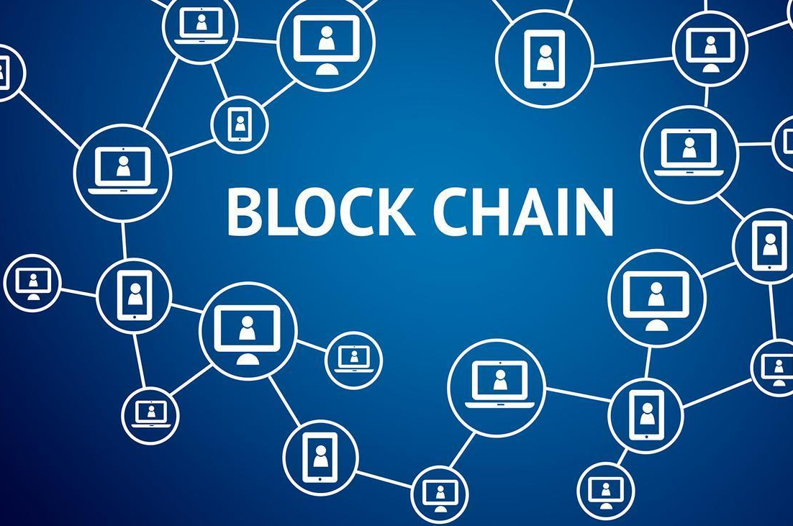
Decentralized Information
Key themes to consider when discussing decentralization
Decentralized Information
Preserve integrity of Information across all actors in the system.
Preserve the confidentiality and integrity of computation when computing on potentially untrusted devices
Support for information aggregation and transactions.
Requires consensus, and distributed ledger.
Blockchains provide a number of key concepts that are essential. For example smart contracts can enable the execution of code remotely on a number of participating devices. However, it is missing a number of concepts:
Confidentiality of computation.
Support for time-critical computation and transaction update [required for cyber-physical system use cases.
Notes:
Advantages of decentralization
Improved cyber & physical reliability by removing single point of failures
Faster decision making by avoiding network penalties due to round-trip to the cloud
Improved scalability
Greater information integrity

Slide 13
Blockchains for SDC: Opportunities and Challenges

Slide 14
Thank you for your attention!
Questions?

